Slide 1

Mahavir Education Trust’s
Shah and Anchor Kutchhi Engineering College, Chembur, Mumbai
(An Autonomous Institute Affiliated to University of Mumbai)
UG Program in Artificial Intelligence & Data Science Bachelor of Technology
Subject Name:- Major Project
Title of the Project:- First Aid Bot
Name of the Student:- Sachi Pandya Reg./Roll No.:- 23US18585AI006
Name of the Student:- Vinit Sangoi Reg./Roll No.:-23US18558AI004
Name of the Student:- Het Shah Reg./Roll No.:-23US18534AI001
Name of the Student:- Harsh Shinde Reg./Roll No.:-21UF16765AI049
Date : 15/10/2025

Slide 2

PRESENTATION FLOW
Problem definition and objectives.
Literature review / background study.
Methodology and implementation details.
Results achieved so far and future work plan.
References and team contributions.

Slide 3
Identification of problem
In emergency situations, people often panic and lack immediate access to medical professionals or accurate first-aid information. Delays in providing correct first aid can worsen the patient’s condition or even become life-threatening. There is a need for a readily available, reliable, and intelligent system that can guide users step-by-step through first-aid procedures for various emergencies.

Slide 4
Objectives
To develop an AI-powered chatbot that provides instant and accurate first-aid guidance to users.
To enable users to interact using natural language (text or voice).
To provide step-by-step instructions for common medical emergencies such as Fatigue, Motion Sickness, Cough, Asthma etc.
To ensure that the chatbot gives safe, verified, and medically accurate responses (based on WHO guidelines).
To build a user-friendly interface accessible on mobile and web platforms.

Slide 5
Literature review / Background Study
Key Insights from Existing Studies:
Studies show that AI chatbots in healthcare improve accessibility to medical information and reduce dependence on human staff for common queries.
First-aid training apps exist, but most lack real-time interaction or AI-driven personalization.
Chatbots like MedChat, HealthTap, and Ada Health show the potential of NLP-based healthcare assistance.
Research emphasizes the importance of trust, accuracy, and user experience in health-related chatbots.
Using Natural Language Processing (NLP) and machine learning models, neural Networks helps in understanding medical intent effectively.

Slide 6
Methodology of proposed work
Our system uses a hybrid approach where four models are trained in parallel on a user-provided CSV dataset (Disease, Symptoms, Remedies) and work together for prediction.
Data Input & Feature Engineering: The system processes the CSV to create TF-IDF vectors (statistical importance) and Symptom Embeddings (semantic relationships).
Parallel Model Training:
TF-IDF + Cosine Similarity: For classic text-based relevance.
Random Forest-like Ensemble: For robust, rule-based pattern detection.
Deep Neural Network (DNN): For complex, non-linear pattern recognition.
Symptom Embedding Model: To understand the contextual relationships between symptoms.
Prediction & Weighted Aggregation: When a user enters symptoms, all four models make a prediction. The results are combined using a weighted average to produce a single, highly accurate set of recommendations.

Slide 7
Implemenation Details
Architecture: 100% Client-Side Application. All processing, training, and prediction happens in the browser, ensuring total user privacy with no server-side dependency.
Technology Stack:
UI: HTML5, CSS3, JavaScript (ES6)
Machine Learning: TensorFlow.js for in-browser Deep Neural Network implementation.
Data Parsing: PapaParse.js for efficient CSV file handling.
Key Feature: The Prediction Fusion mechanism intelligently weighs the output from each of the four models, prioritizing those best suited for the query, to deliver a superior and more reliable final answer.

Slide 8
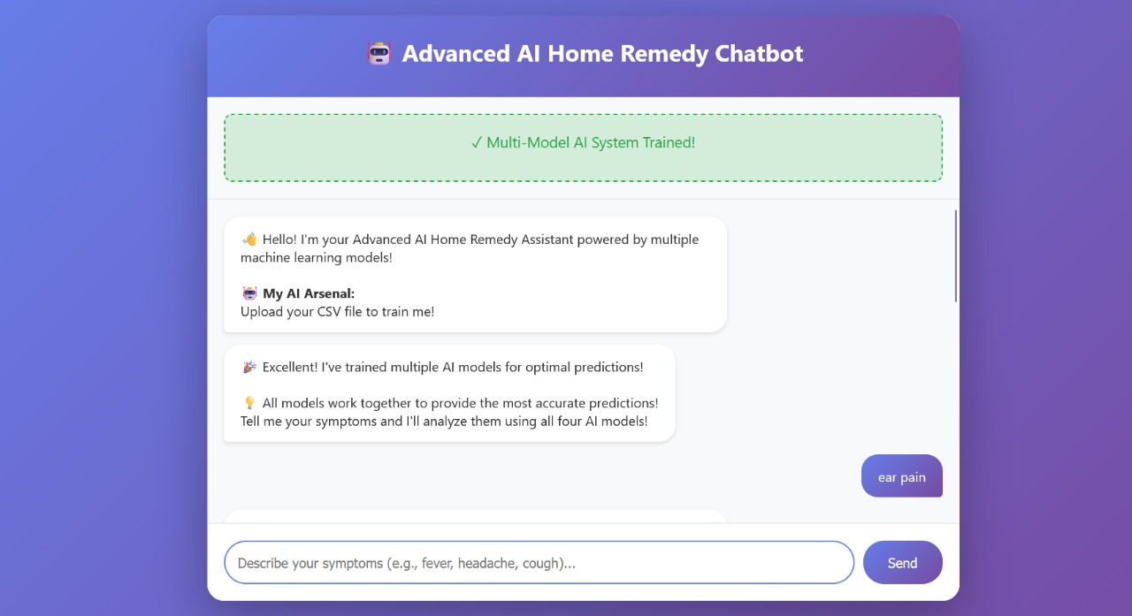
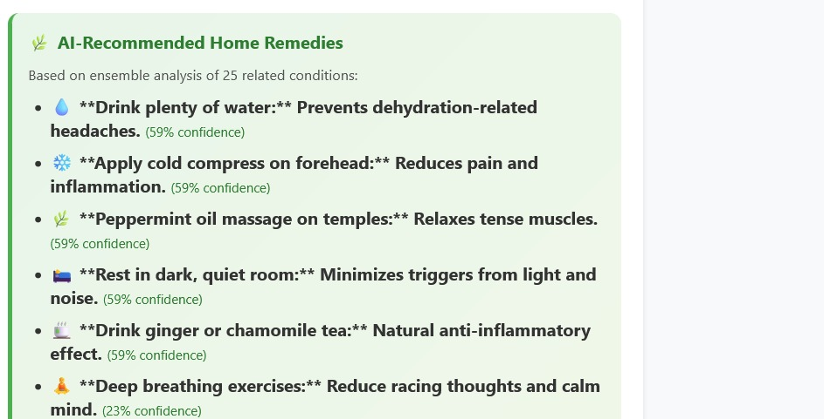
Results achieved

Slide 9
Future Plan
Add voice recognition for hands-free communication.
Integrate location-based hospital finder using Google Maps API.
Include multilingual support for regional languages.
Improve model accuracy with real user data feedback.
Add image recognition to identify injuries and provide visual guidance.
Making the dataset in Categories

Slide 10
References
World Health Organization – Basic First Aid Guidelines.
Red Cross – First Aid Manual.
Research paper: “Conversational AI in Healthcare: A Review of Chatbots”, IEEE Access, 2022.
Ada Health (https://ada.com) and HealthTap platforms.

Slide 11
Conclusion
The First Aid Bot serves as a reliable and accessible tool for providing immediate medical guidance during emergencies. By offering quick, accurate, and situation-specific first aid information, it bridges the gap between the onset of an emergency and professional medical help. This project demonstrates how technology can be leveraged to enhance healthcare awareness, reduce panic, and potentially save lives. With further integration of AI and real-time response features, the First Aid Bot can evolve into a vital component of modern emergency response systems.

Slide 12
THANK YOU

